Slide 1
YBCO/Gd

Slide 2
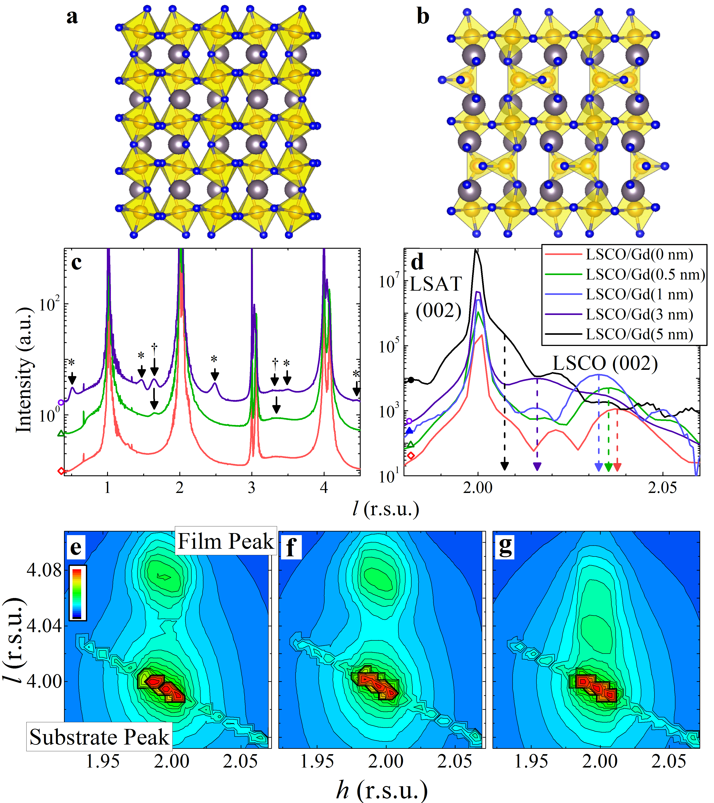
Background – Previous Studies
Previous work on La_{0.7}Sr_{0.3}MnO₃/Gd and La_{0.7}Sr_{0.3}CoO₃/Gd perovskite systems [1-2], as well as an exchange-coupled NiCoO/GdFe bilayer [3], has shown that Gd capping layers can significantly alter the oxygen distribution in the oxide film underneath.
Gd, which has an extremely high oxygen affinity due to its low work function and large enthalpy of formation (of Gd₂O₃), initiates a room-temperature solid state redox reaction at the interface. Combined with the high ionic conductivity of Gd₂O₃ [4], these effects can lead to significant oxygen migration from the underlying film toward the interface, introducing oxygen vacancies.
These studies have shown large changes in transport properties and magnetic behavior, as well as the unusual formation of stable oxygen deficient phases (Brownmillerite) at room temperature.
Previous work:
Before Gd deposition:
Perovskite La_{0.7}Sr_{0.3}CoO₃
After Gd deposition:
Brownmillerite La_{0.7}Sr_{0.3}CoO_{2.5}
[1] Alexander J. Grutter, Dustin A. Gilbert, Elke Arenholz, Kai Liu, Brain B. Maranville, Julie Borchers, Brian J. Kirby "Reversible Control of Magnetism in La0.67Sr0.33MnO3 Through Chemically-Induced Oxygen Migration" Applied Physics Letters 108, 082405 (2016).
[2] Dustin A. Gilbert, Alexander J. Grutter, Peyton D. Murray, Rajesh V. Chopdekar, Alexander M. Kane, Aleksey L. Ionin, Michael S. Lee, Steven R. Spurgeon, Brian J. Kirby, Brian B. Maranville, Alpha T. N’Diaye, Apurva Mehta, Elke Arenholz, Kai Liu, Yayoi Takamura, and Julie A. Borchers, “Ionic Tunic of Cobaltites at the Nanoscale“, Submitted.
[3] Dustin A. Gilbert, J. Olamit, R. K. Dumas, B. J. Kirby, A. J. Grutter, B. B. Maranville, E. Arenholz, J. A. Borchers, and Kai Liu, “Tunable Positive Exchange Bias via Redox-Driven Oxygen Migration”, Nature Communications, 7, 11050 (2016).
[4] Dustin A. Gilbert, Alexander. J Grutter, Elke Arenholz, Kai Liu, Brian J. Kirby, Julie Borchers, Brain B. Maranville "Structural and Magnetic Depth Profiles of Magneto-Ionic Heterostructures Beyond the Interface", Nature Communications 7, 12264 (2016).

Slide 3
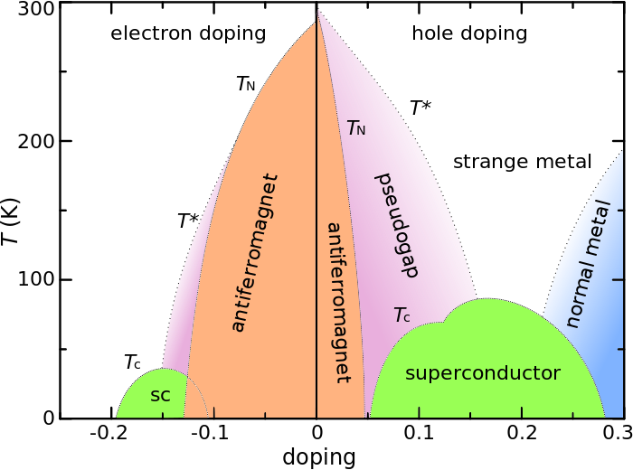
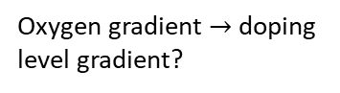
Background - YBCO
Optimal doping (p=0.16)
We wanted to extend this idea to the more widely studied YBCO system because it is of more general interest, is widely studied and easy to get in thin film form, and has been reported to have high ionic conductivity.
Importantly, the various types of electronic order observed in the cuprates (and oxypnictides...) depends strongly on charge carrier doping level, a material property than can be tuned by altering the oxygen stoichiometry.
PNR studies on the LSMO, LSCO, and NiCoO systems mentioned previously have shown that Gd chemically removes oxygen from the underlayer in a gradient, with strongest gettering activity occurring at the interface. In a YBCO/Gd bilayer, it may therefore be possible to access multiple charge doping levels simultaneously as a function of depth away from the metal/oxide interface.
From a fundamental physics viewpoint, understanding the interplay between various competing types of electronic order is an important part of explaining the global phase diagram. Being able to fabricate samples with several coexisting phases, as we expect for YBCO/Gd, is useful for the experimental side of this problem.
Additionally, future device applications of similar materials will require precisely controllable material parameters. By changing the thickness of Gd capping layer used, our previous work has demonstrated the versatility of this technique in tuning the oxygen content of the oxide film underlayer.
Au (10 nm)
Three samples were fabricated:
YBCO (100 nm)/Gd (3, 7, 20 nm)/Au (10 nm)
A fourth sample was kept in the as-grown state for comparison.
Gd (3, 7, 20 nm)
YBCO (100 nm)
Oxygen gradient $→$ doping level gradient?
STO (substrate)

Slide 4
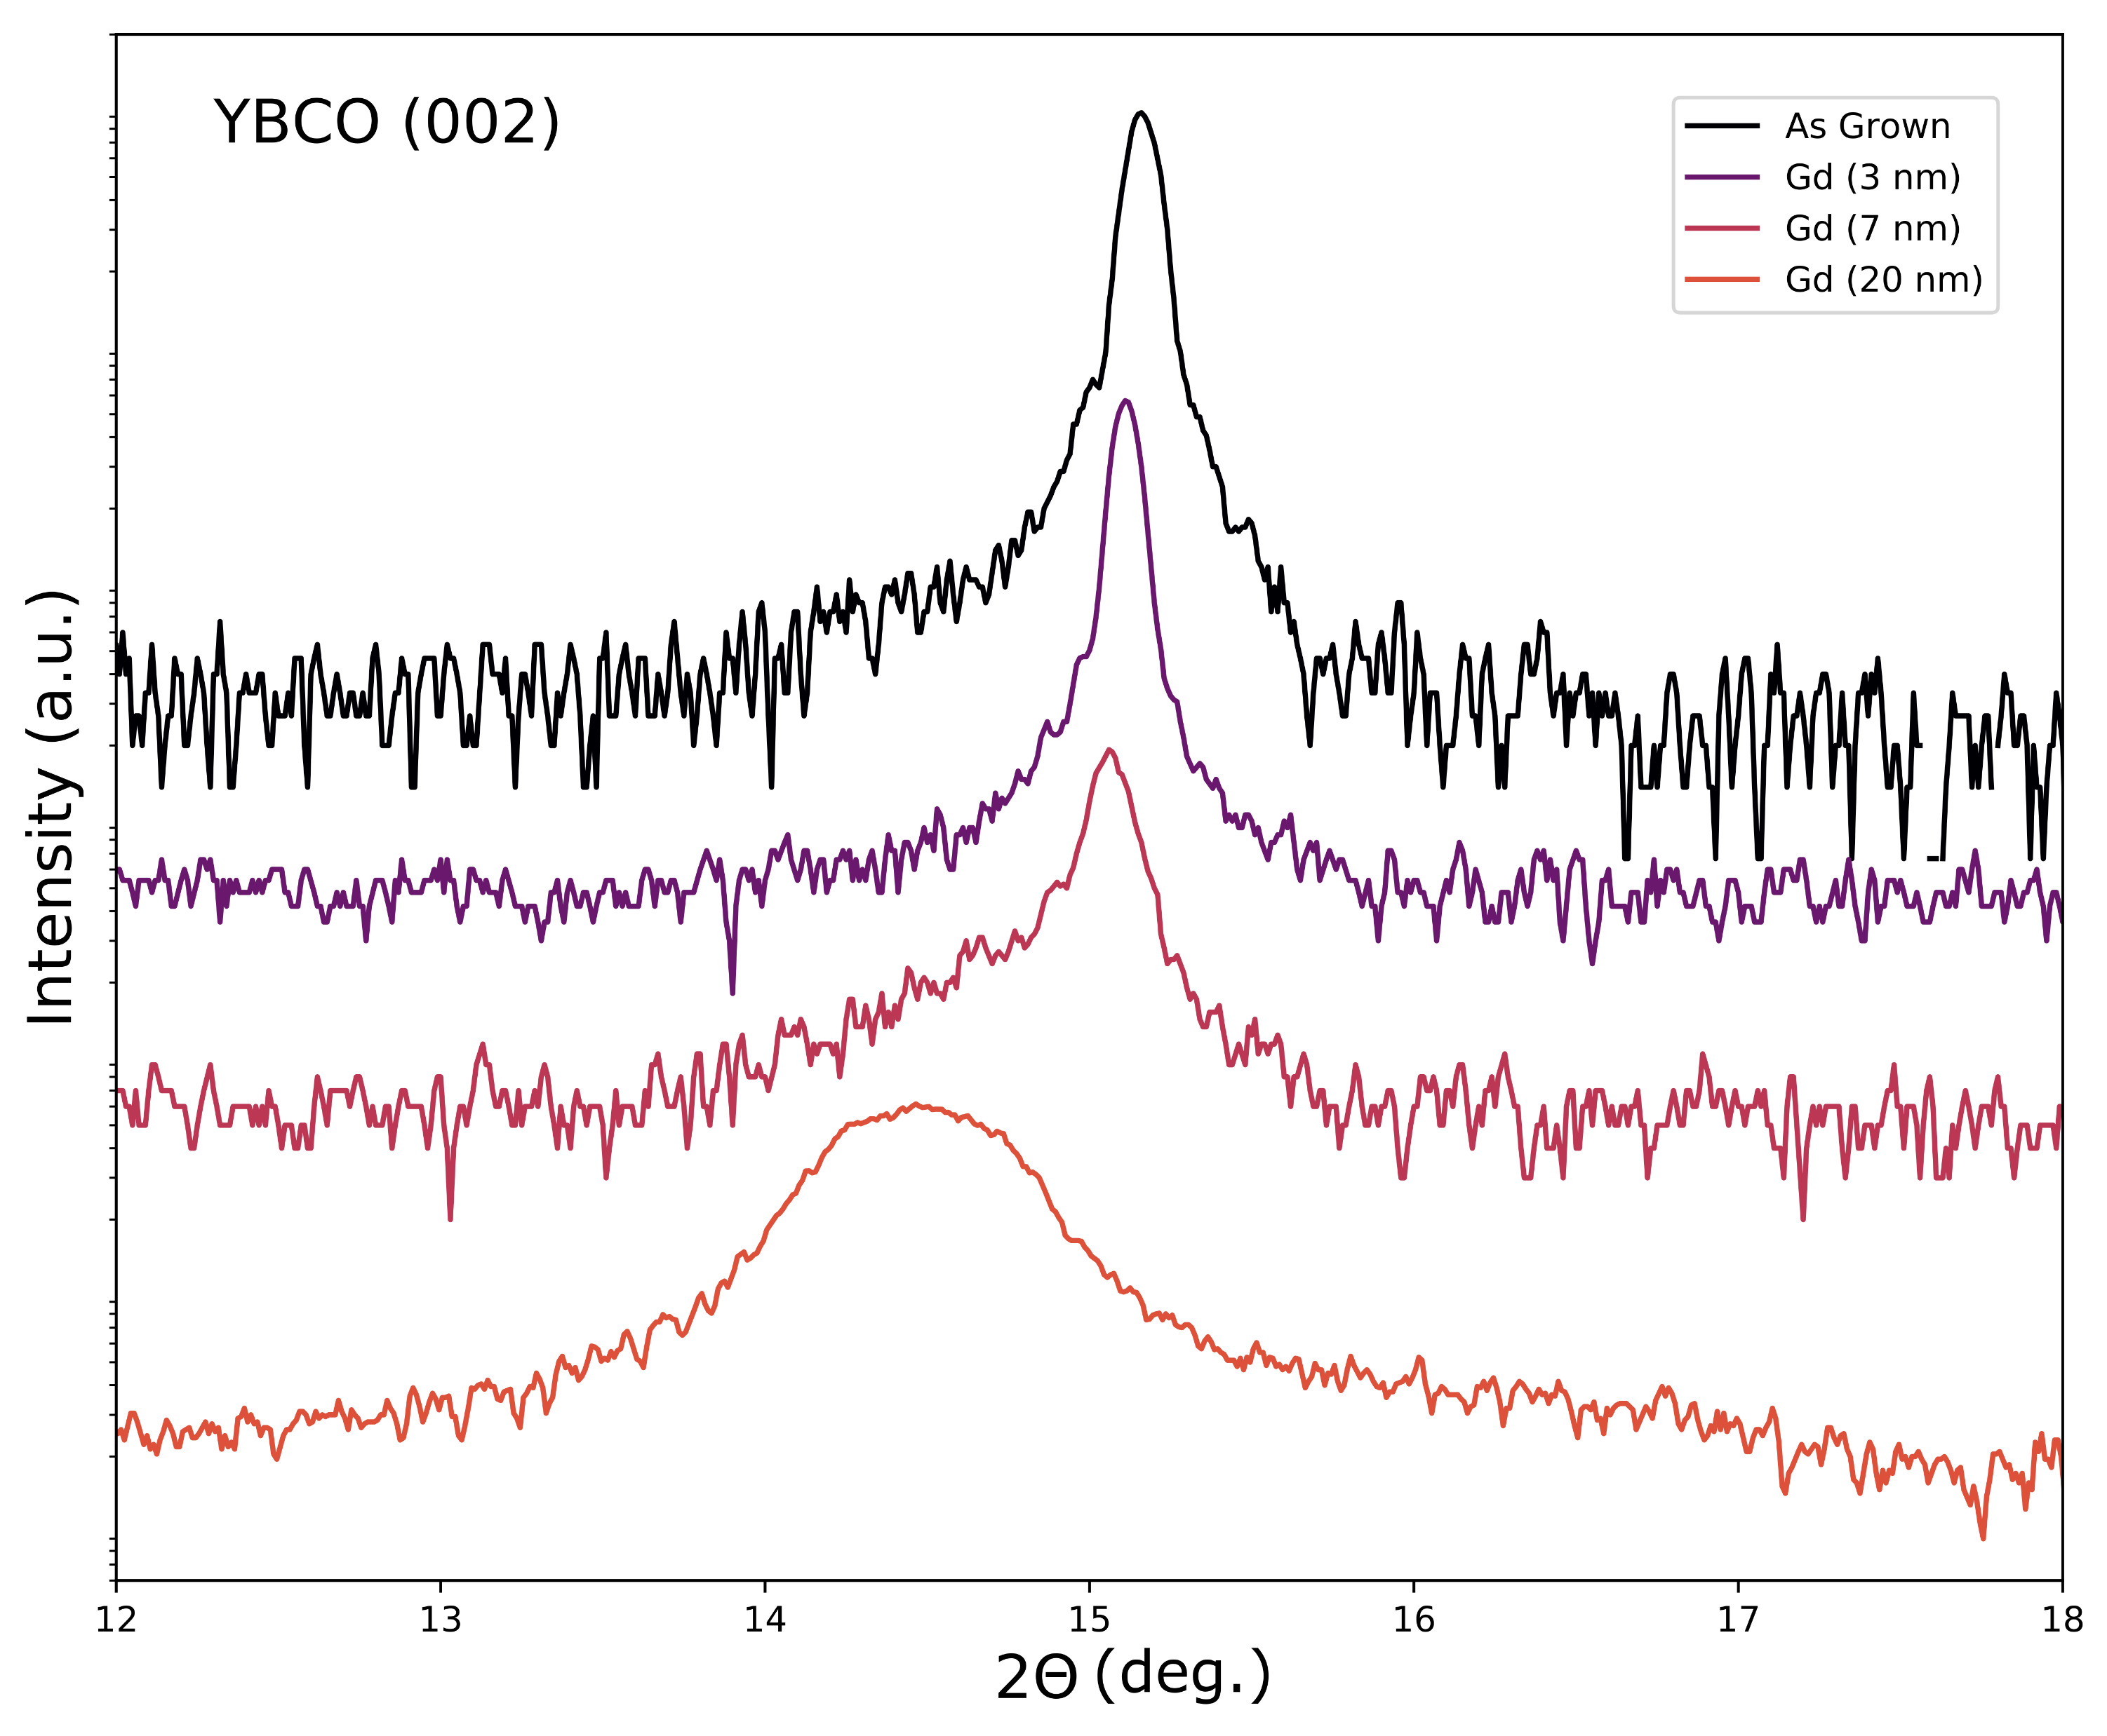
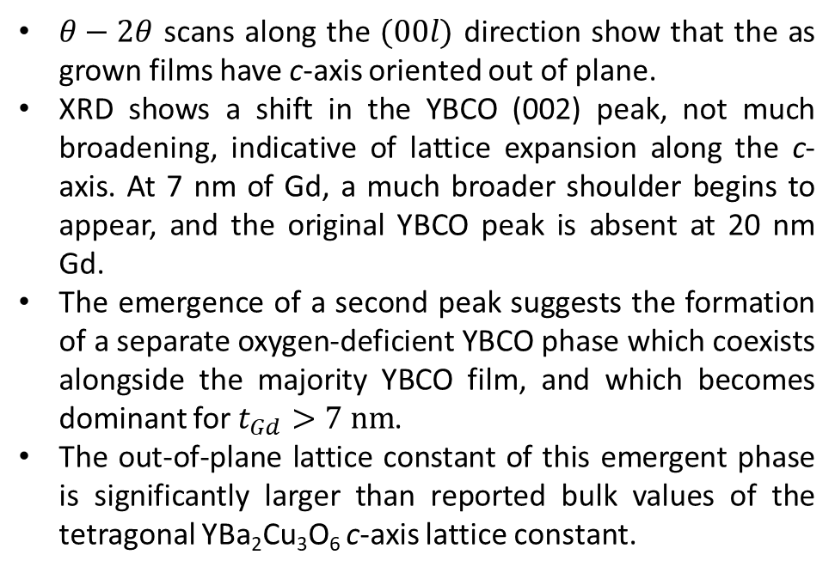
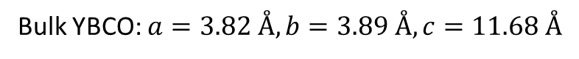
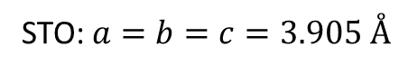
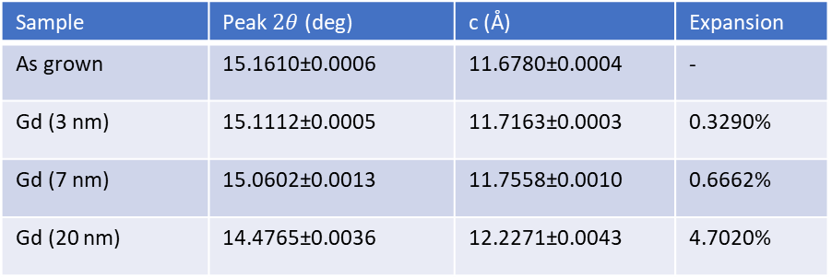
X-Ray Diffraction
$θ−2θ$ scans along the $(00l)$ direction show that the as grown films have c-axis oriented out of plane.
XRD shows a shift in the YBCO (002) peak, not much broadening, indicative of lattice expansion along the c-axis. At 7 nm of Gd, a much broader shoulder begins to appear, and the original YBCO peak is absent at 20 nm Gd.
The emergence of a second peak suggests the formation of a separate oxygen-deficient YBCO phase which coexists alongside the majority YBCO film, and which becomes dominant for $t_{Gd}>7 nm$.
The out-of-plane lattice constant of this emergent phase is significantly larger than reported bulk values of the tetragonal YBa₂Cu₃O₆ c-axis lattice constant.
Sample | Peak $2θ$ (deg) | c (Å) | Expansion
As grown | 15.1610±0.0006 | 11.6780±0.0004 | -
Gd (3 nm) | 15.1112±0.0005 | 11.7163±0.0003 | 0.3290%
Gd (7 nm) | 15.0602±0.0013 | 11.7558±0.0010 | 0.6662%
Gd (20 nm) | 14.4765±0.0036 | 12.2271±0.0043 | 4.7020%
Bulk YBCO: $a=3.82 Å, b=3.89 Å, c=11.68 Å$
STO: $a=b=c=3.905 Å$

Slide 5
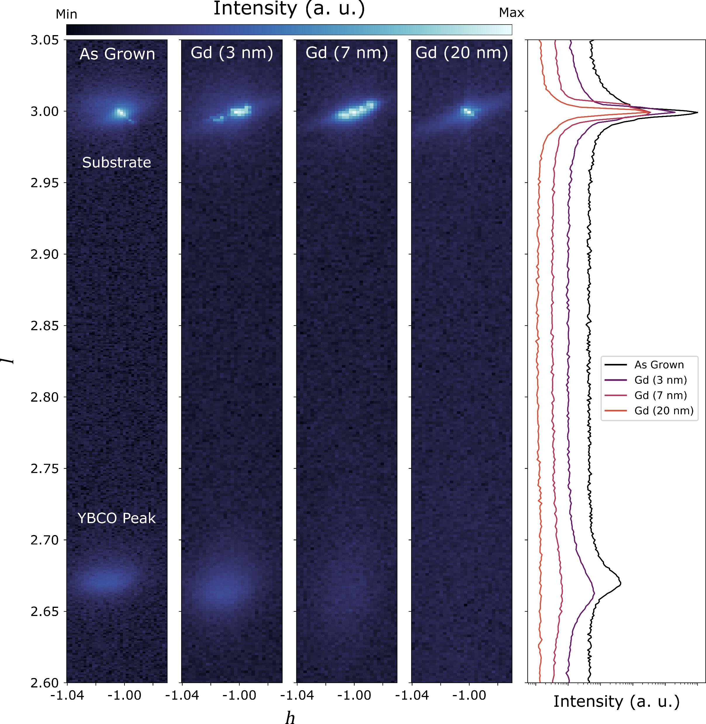
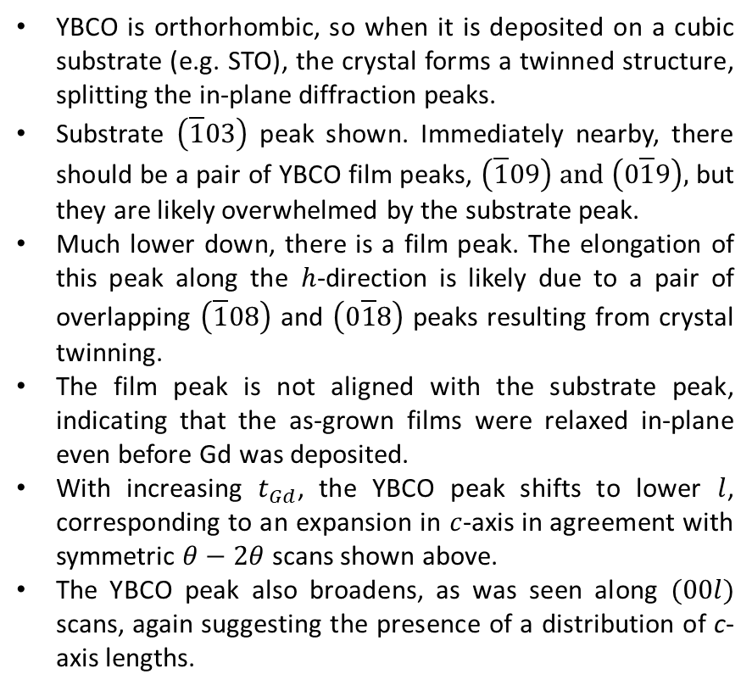
Reciprocal Space Maps
YBCO is orthorhombic, so when it is deposited on a cubic substrate (e.g. STO), the crystal forms a twinned structure, splitting the in-plane diffraction peaks.
Substrate $\left(\overline{1}03\right)$ peak shown. Immediately nearby, there should be a pair of YBCO film peaks, $\left(\overline{1}09\right) and \left(0\overline{1}9\right),$ but they are likely overwhelmed by the substrate peak.
Much lower down, there is a film peak. The elongation of this peak along the $h$-direction is likely due to a pair of overlapping $\left(\overline{1}08\right)$ and $\left(0\overline{1}8\right)$ peaks resulting from crystal twinning.
The film peak is not aligned with the substrate peak, indicating that the as-grown films were relaxed in-plane even before Gd was deposited.
With increasing $t_{Gd}$, the YBCO peak shifts to lower $l$, corresponding to an expansion in $c$-axis in agreement with symmetric $θ−2θ$ scans shown above.
The YBCO peak also broadens, as was seen along $(00l)$ scans, again suggesting the presence of a distribution of c-axis lengths.

Slide 6
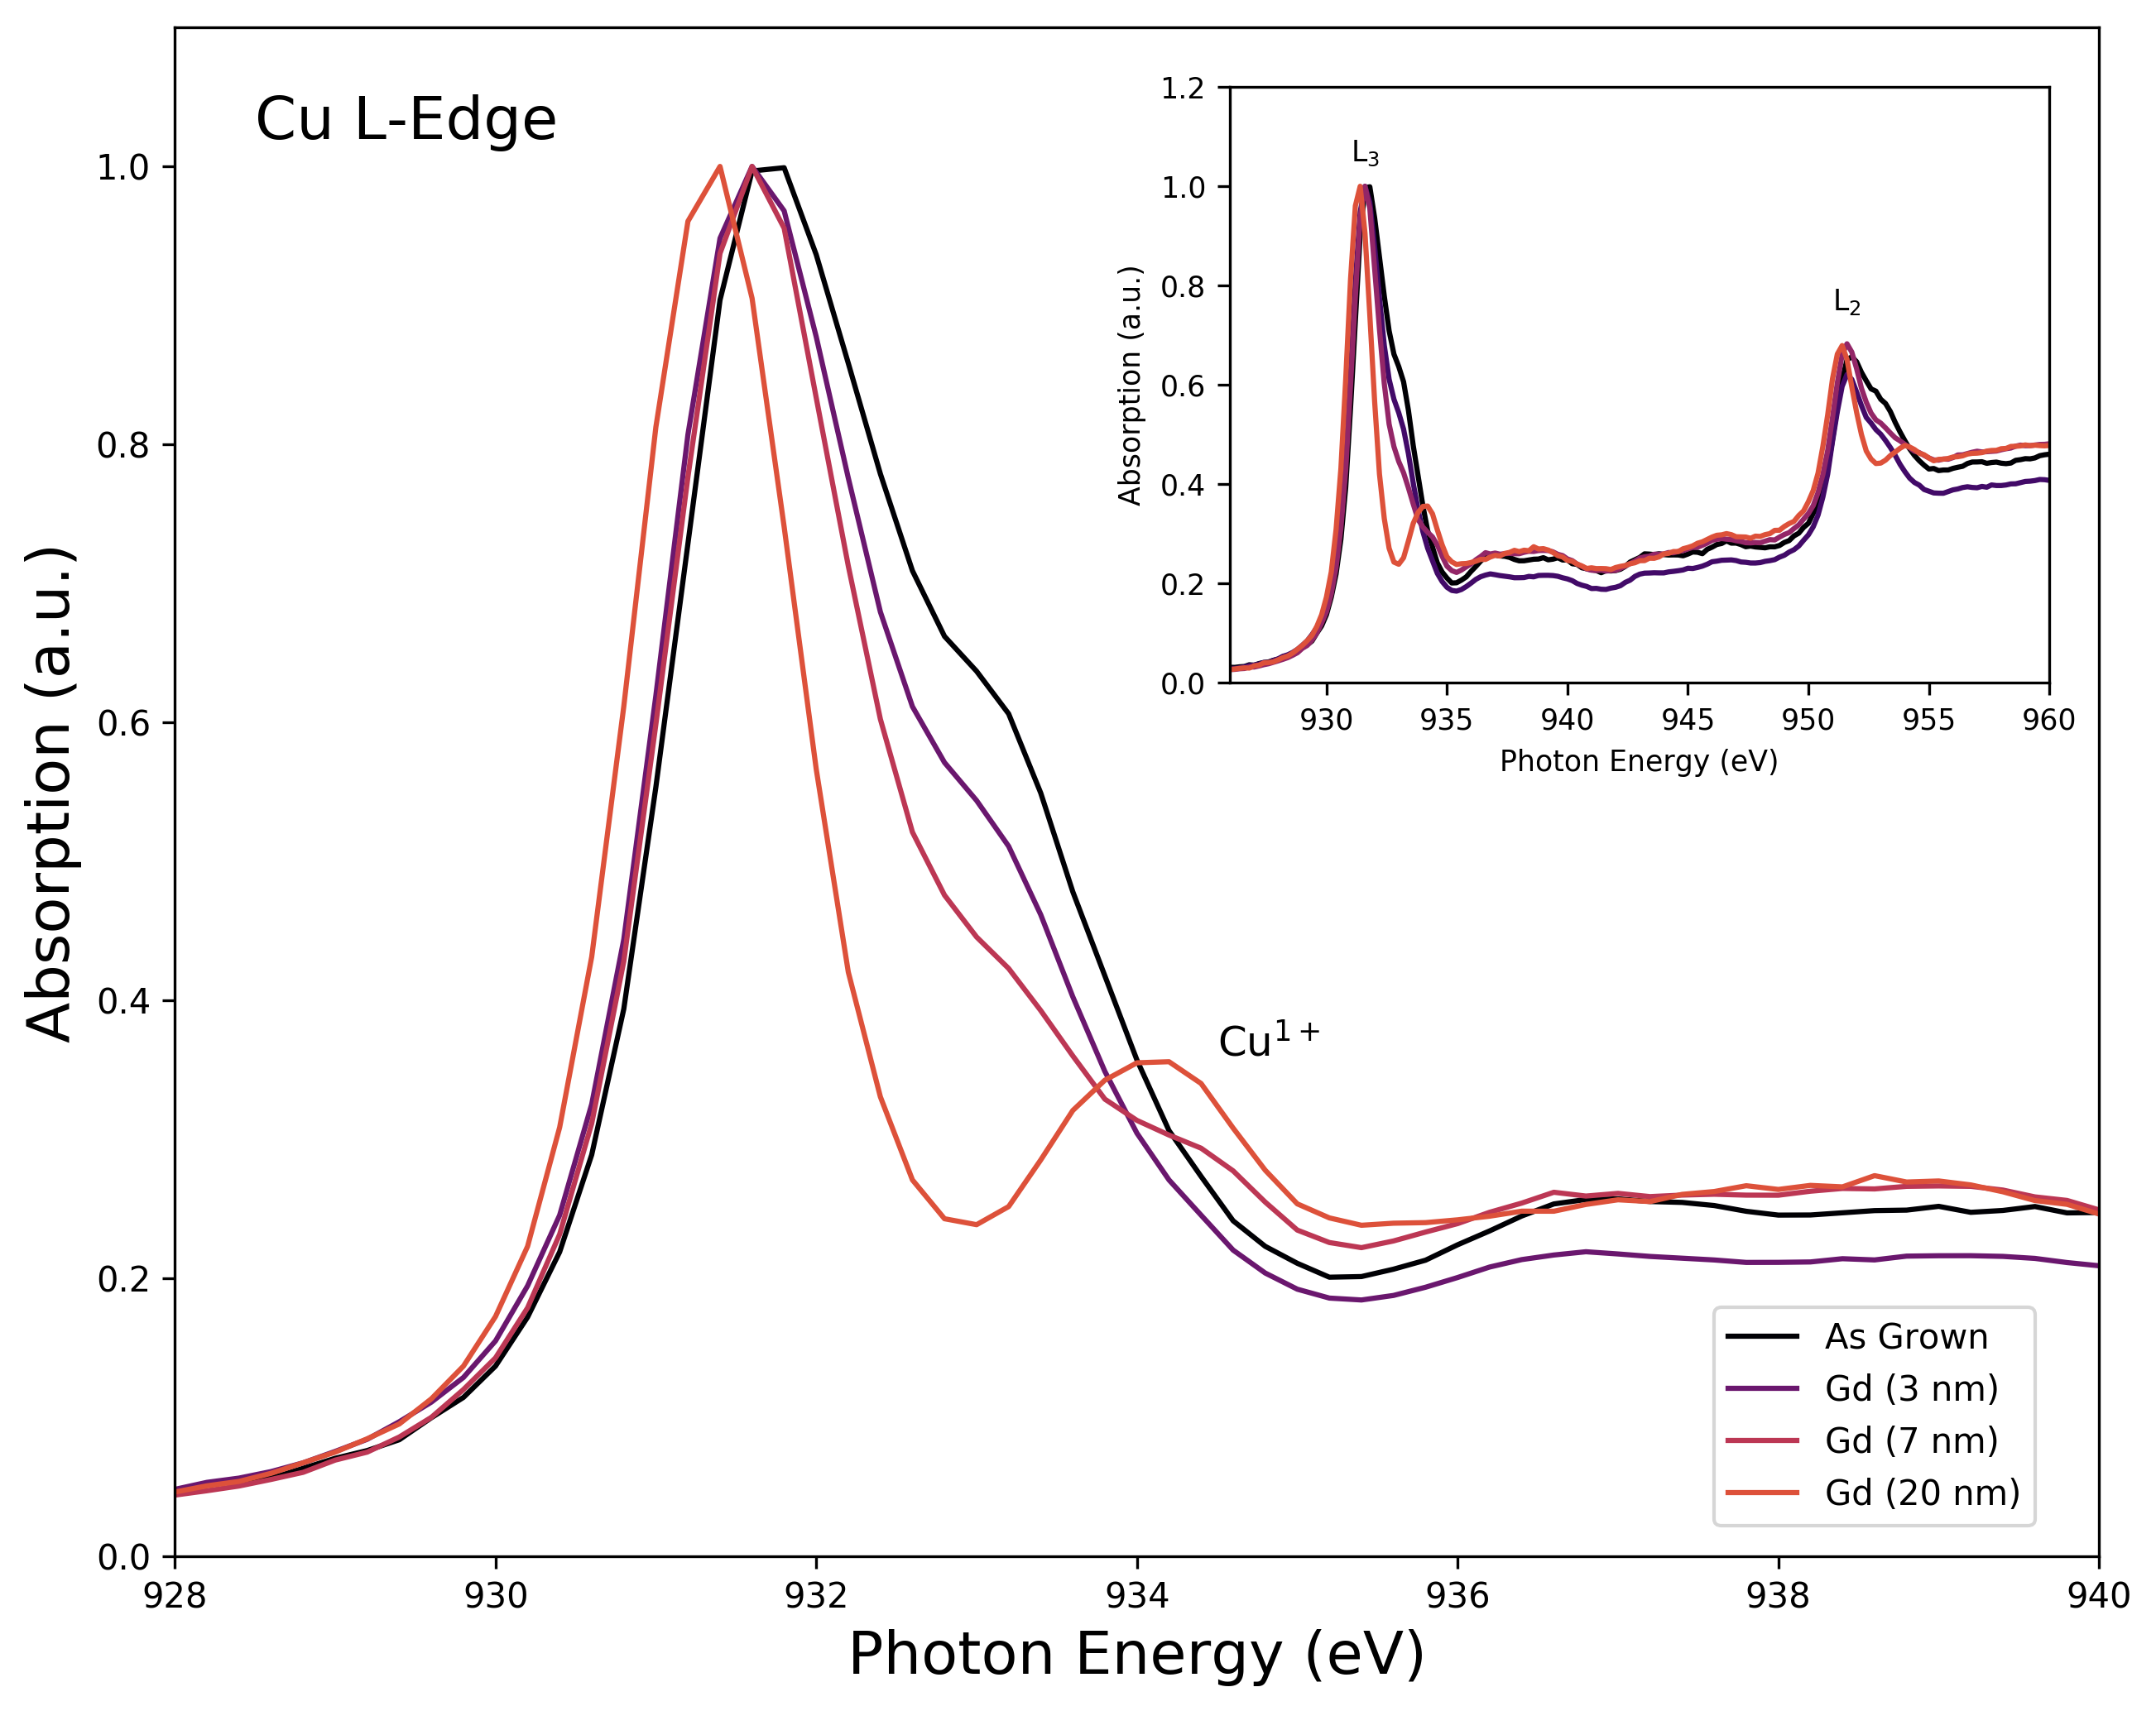
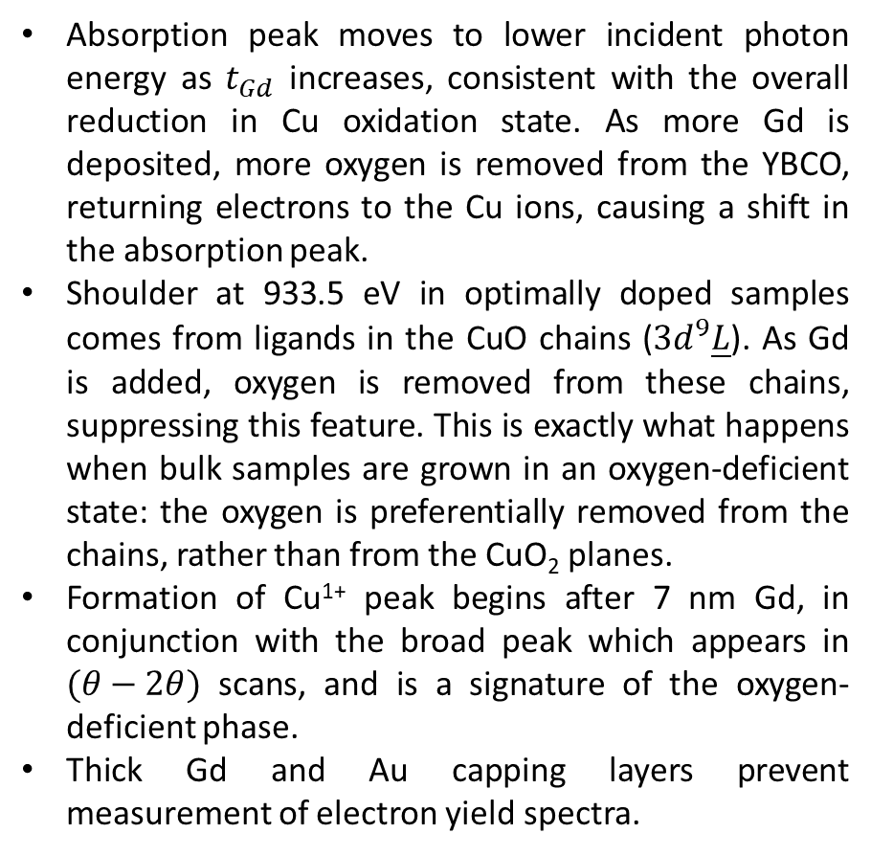
X-Ray Aborption Spectra (Fluorescence Yield)
Absorption peak moves to lower incident photon energy as $t_{Gd}$ increases, consistent with the overall reduction in Cu oxidation state. As more Gd is deposited, more oxygen is removed from the YBCO, returning electrons to the Cu ions, causing a shift in the absorption peak.
Shoulder at 933.5 eV in optimally doped samples comes from ligands in the CuO chains ($3d^{9}\underline{L}$). As Gd is added, oxygen is removed from these chains, suppressing this feature. This is exactly what happens when bulk samples are grown in an oxygen-deficient state: the oxygen is preferentially removed from the chains, rather than from the CuO₂ planes.
Formation of Cu¹⁺ peak begins after 7 nm Gd, in conjunction with the broad peak which appears in $(θ−2θ)$ scans, and is a signature of the oxygen-deficient phase.
Thick Gd and Au capping layers prevent measurement of electron yield spectra.

Slide 7
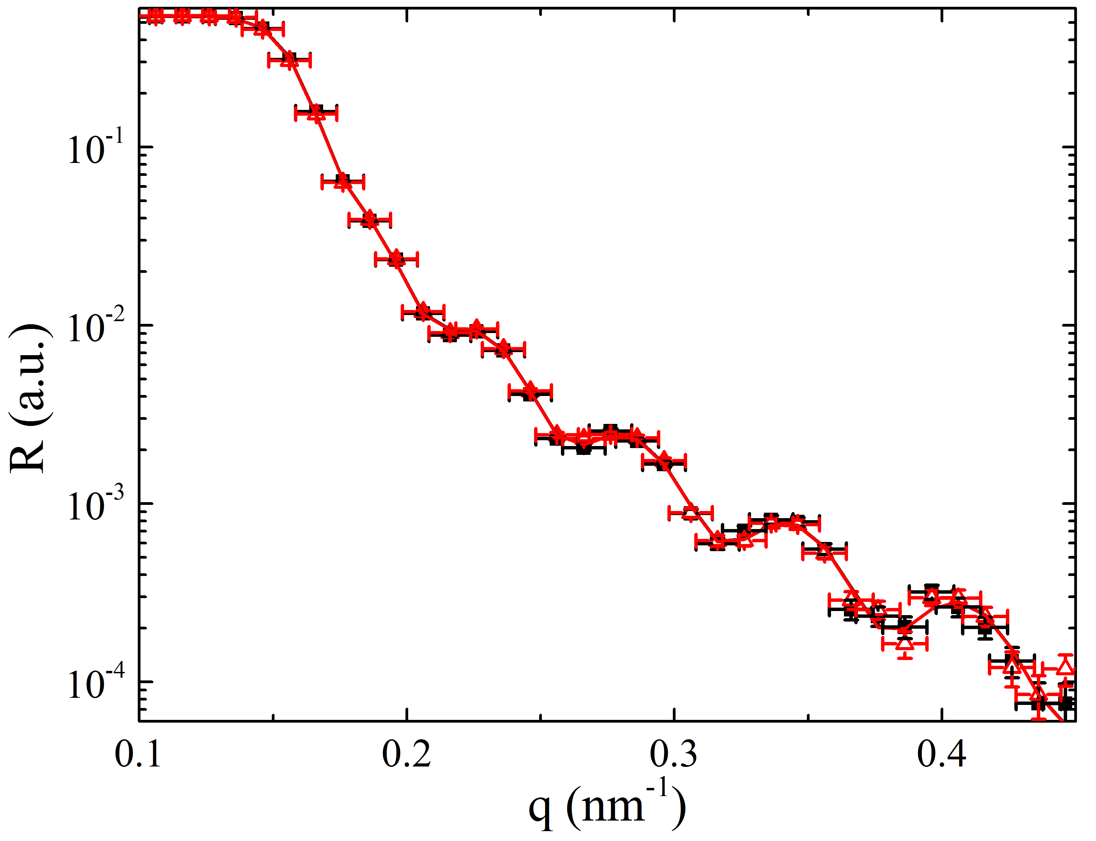
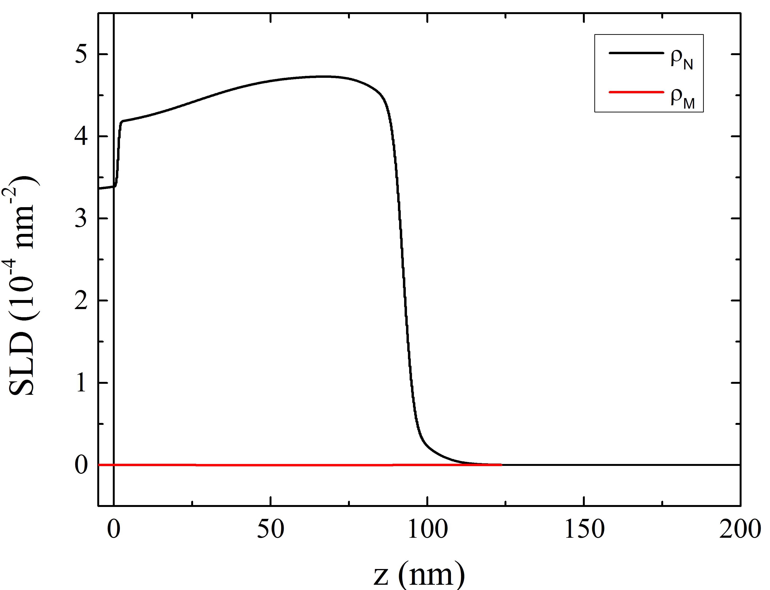
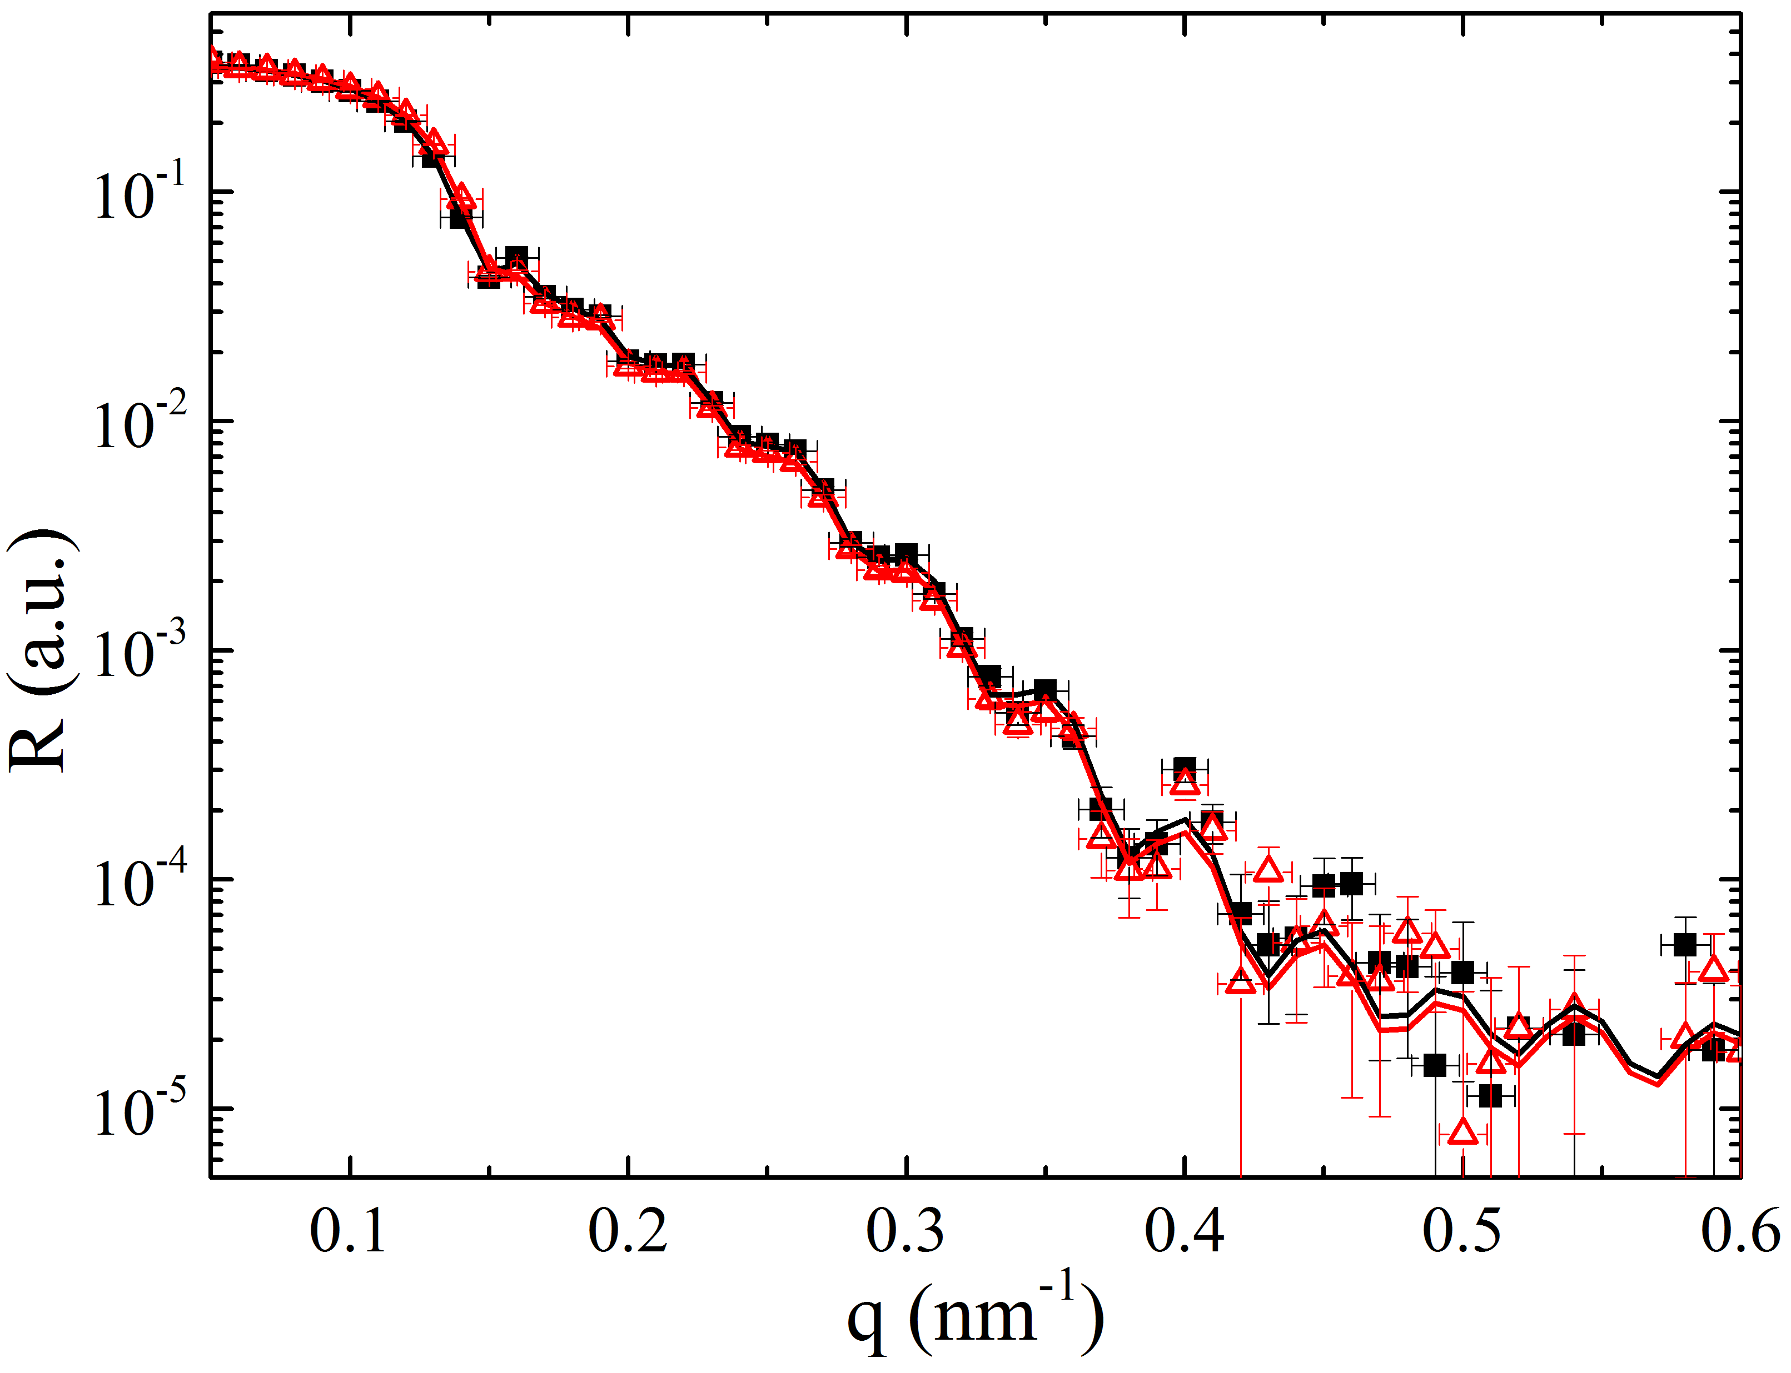
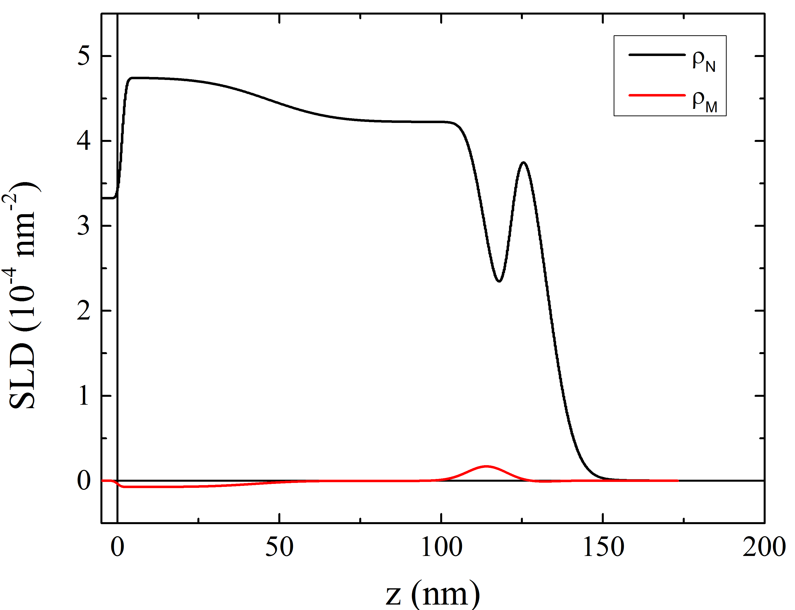
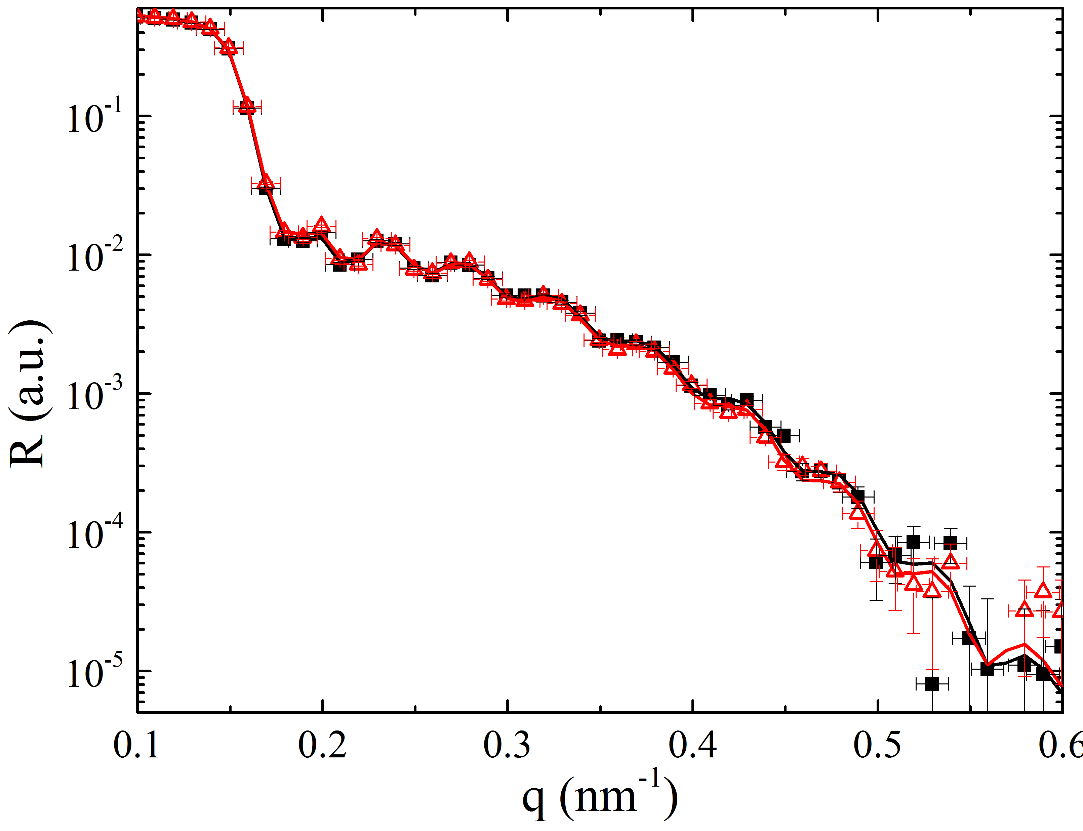
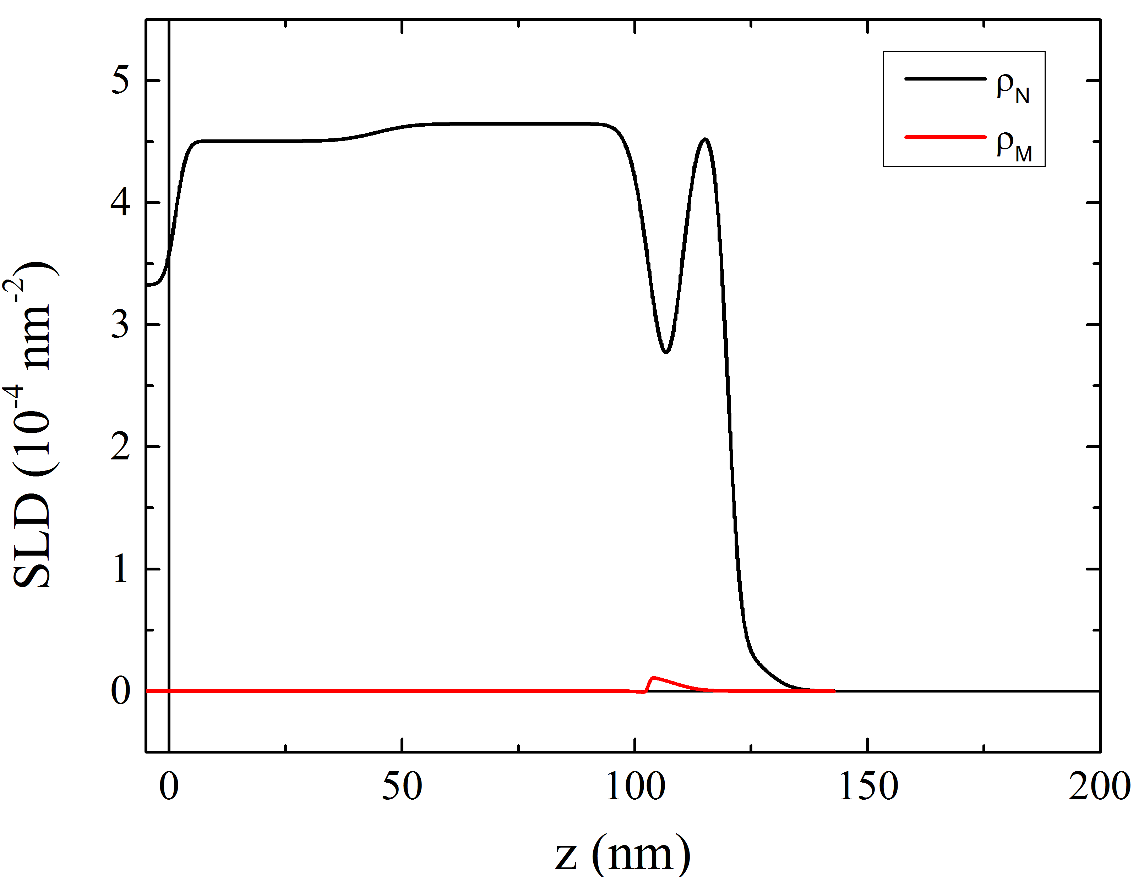
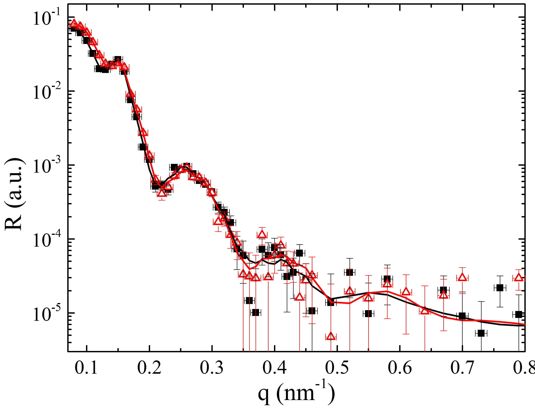
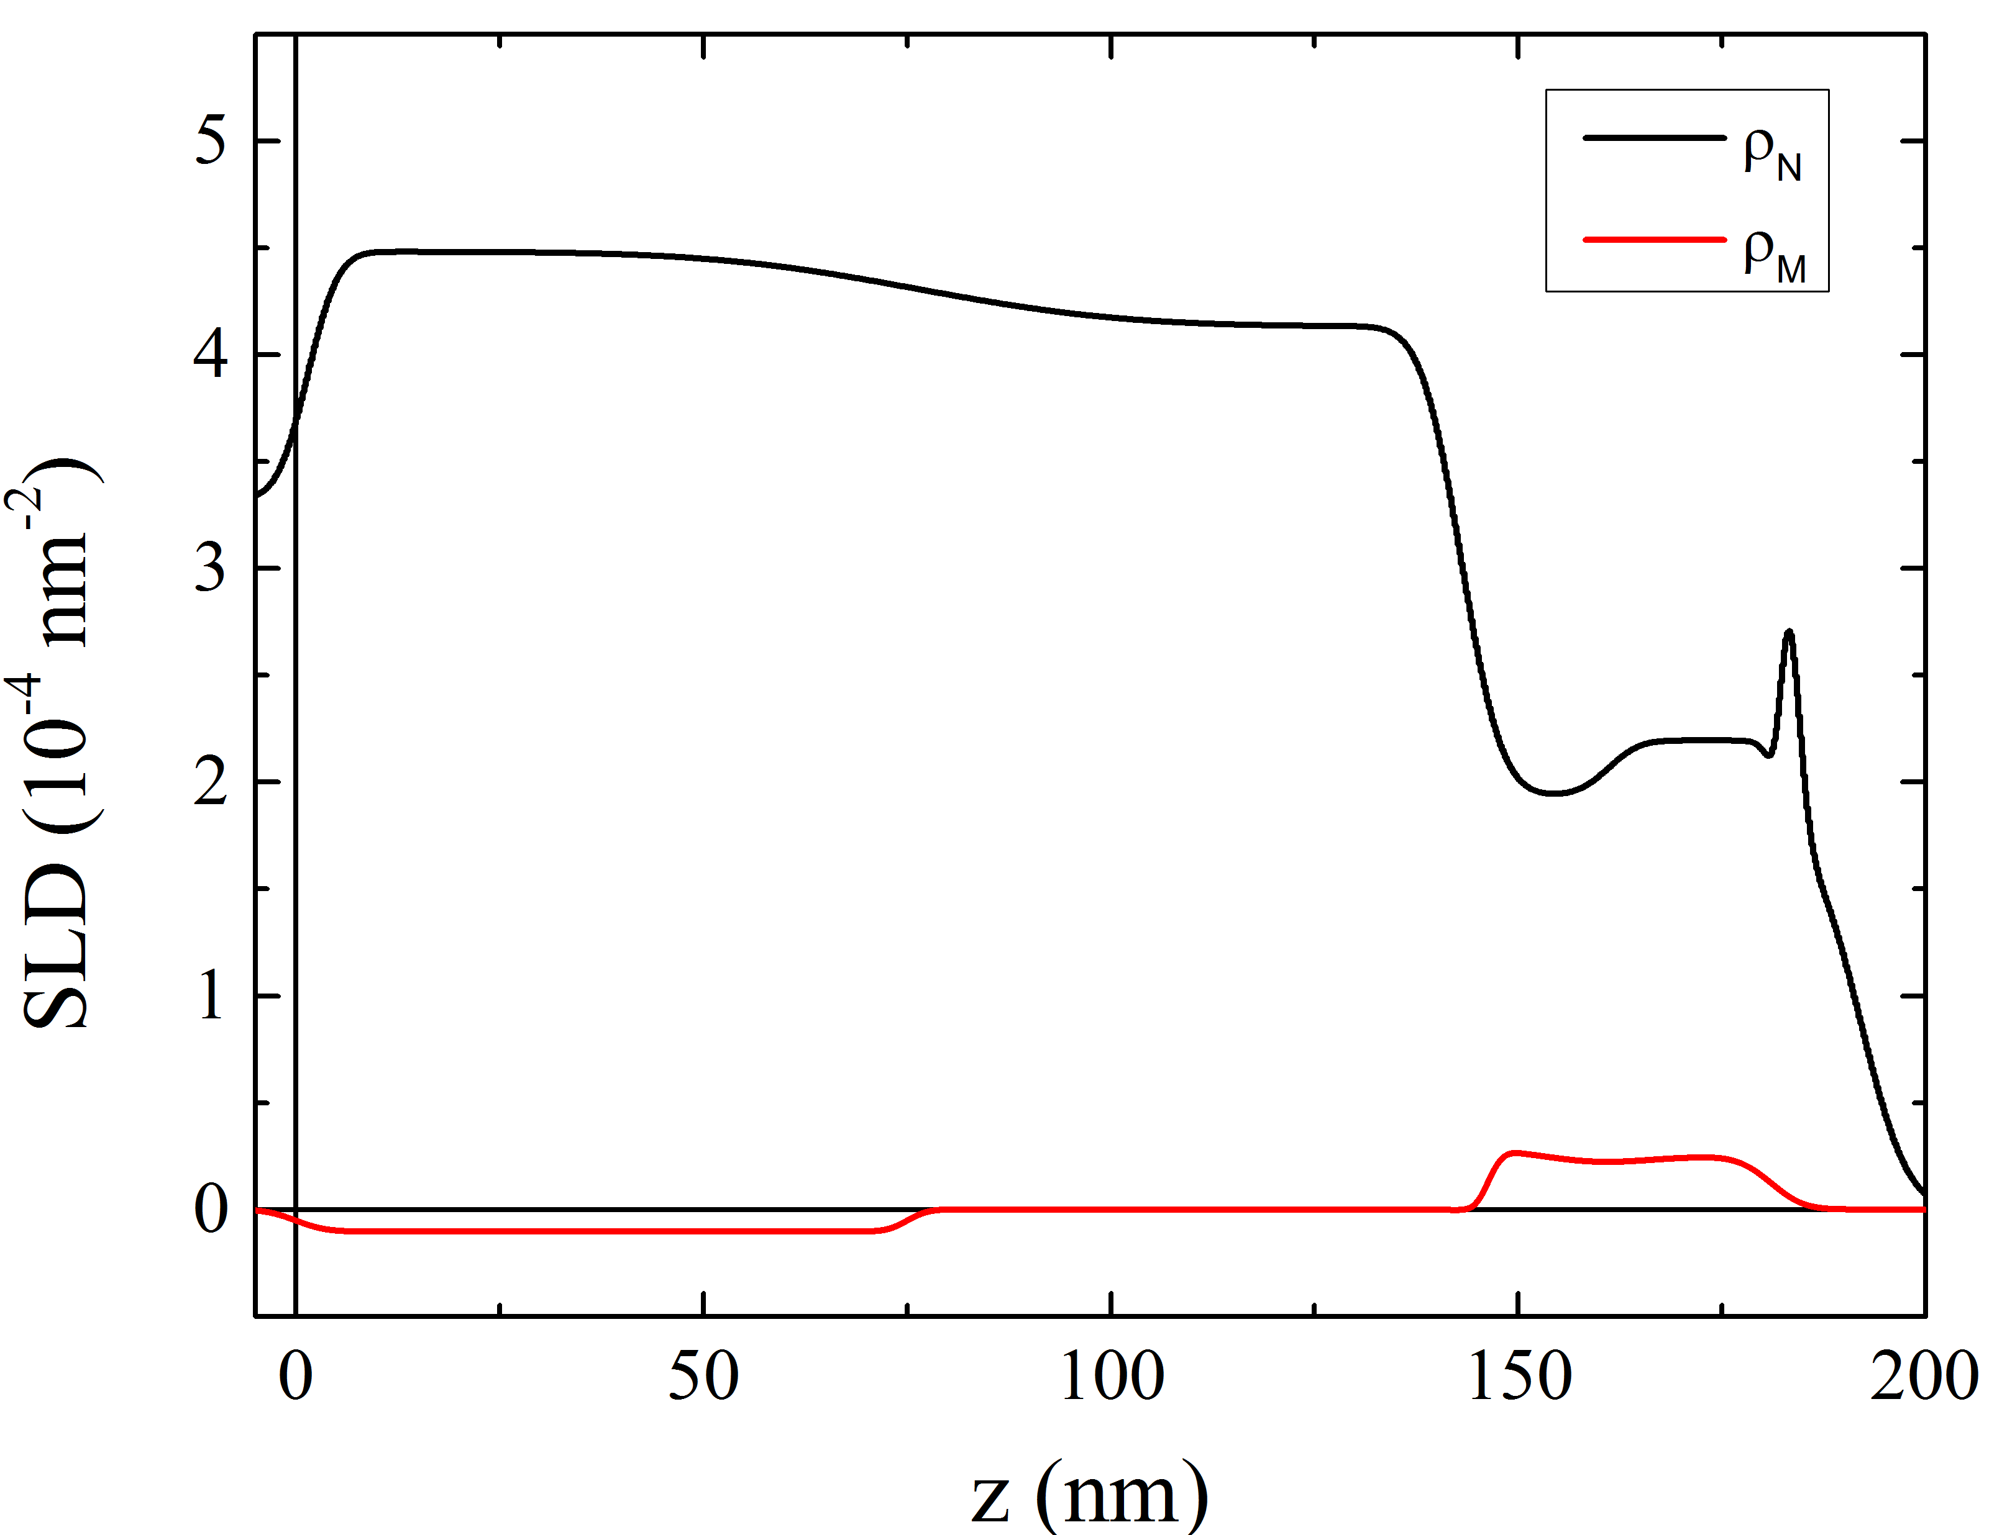
Polarized Neutron Reflectometry
YBCO As Grown
YBCO/Gd(7 nm)
YBCO/Gd(3 nm)
YBCO/Gd(20 nm)

Slide 8
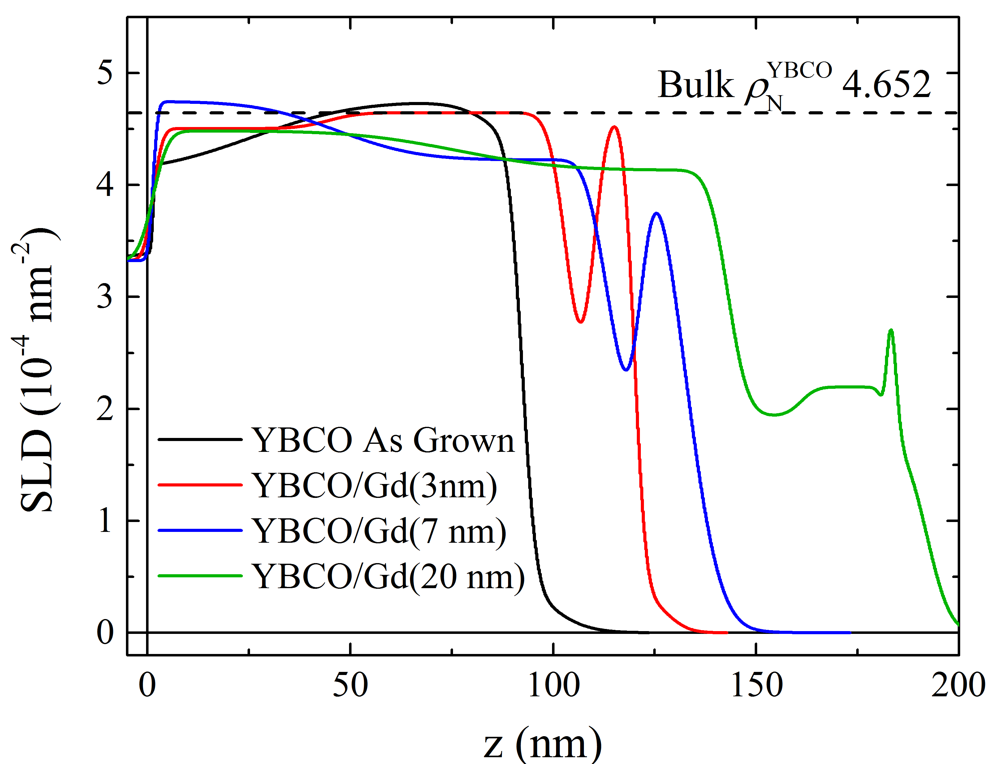
Polarized Neutron Reflectometry
Preliminary data: better fits forthcoming from Alex
Nuclear scattering length densities (SLDs) show effective density of nuclear scattering centers, and is sensitive to the presence of oxygen.
When newer fits come in, this figure will be updated.

Slide 9
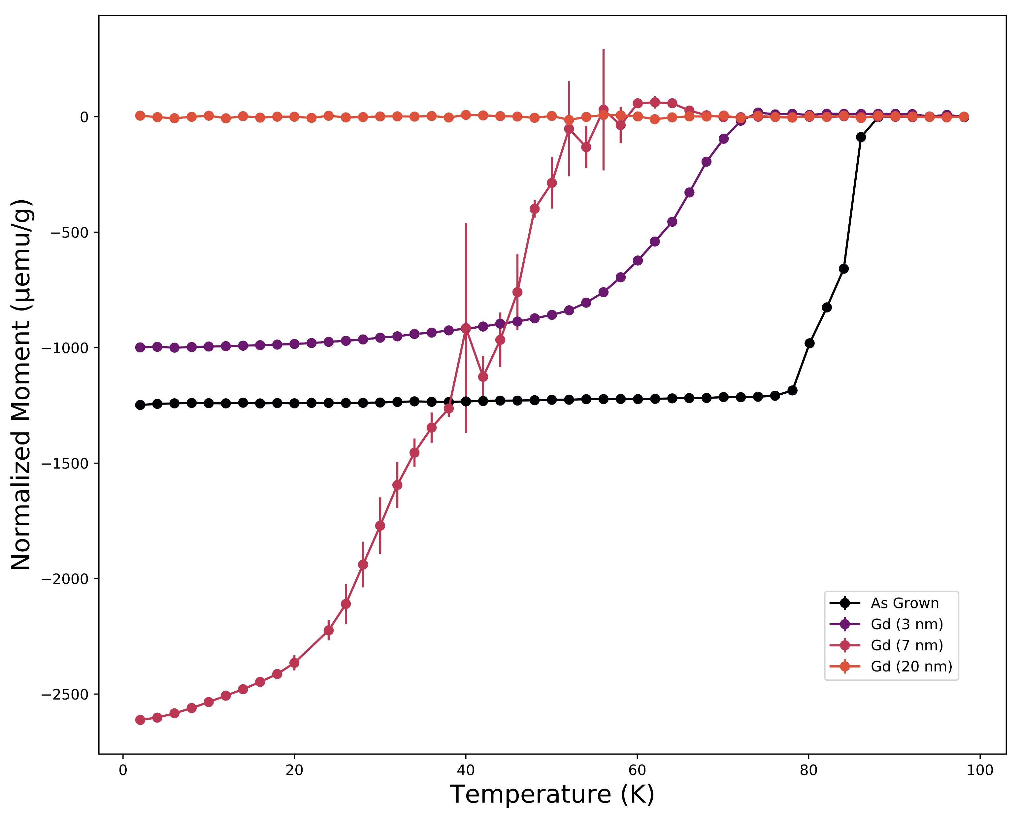
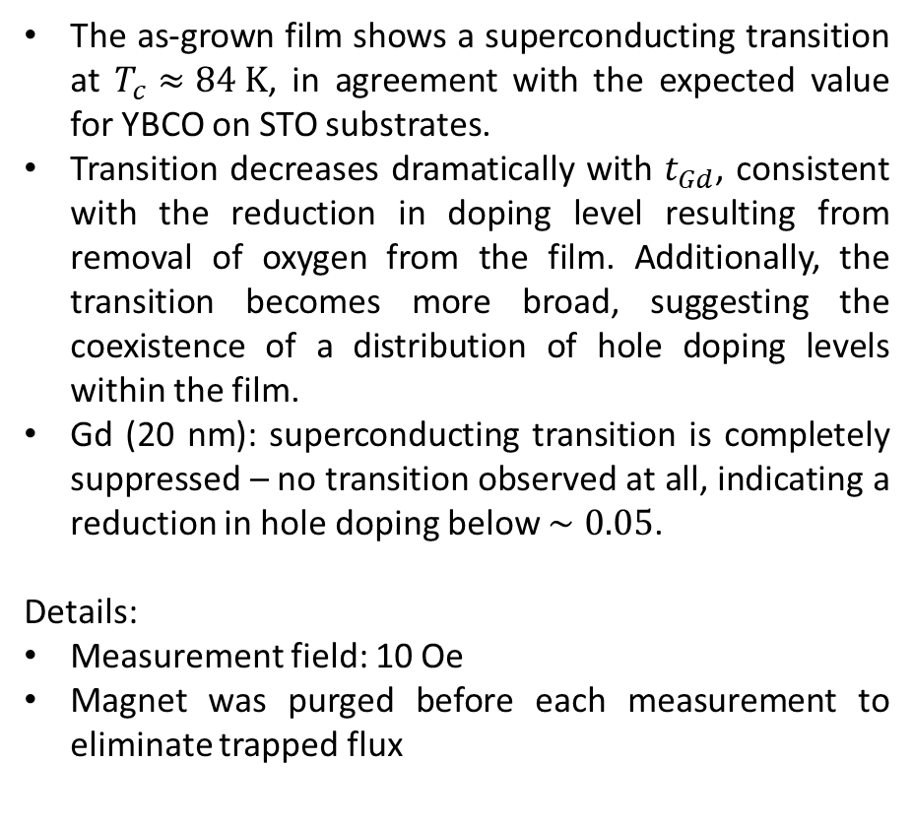
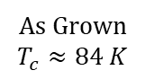
Magnetometry
Moment/Sample mass
The as-grown film shows a superconducting transition at $T_{c}≈84 K$, in agreement with the expected value for YBCO on STO substrates.
Transition decreases dramatically with $t_{Gd}$, consistent with the reduction in doping level resulting from removal of oxygen from the film. Additionally, the transition becomes more broad, suggesting the coexistence of a distribution of hole doping levels within the film.
Gd (20 nm): superconducting transition is completely suppressed – no transition observed at all, indicating a reduction in hole doping below $∼0.05$.
Details:
Measurement field: 10 Oe
Magnet was purged before each measurement to eliminate trapped flux
As Grown
$$T_{c}≈84 K$$

Slide 10
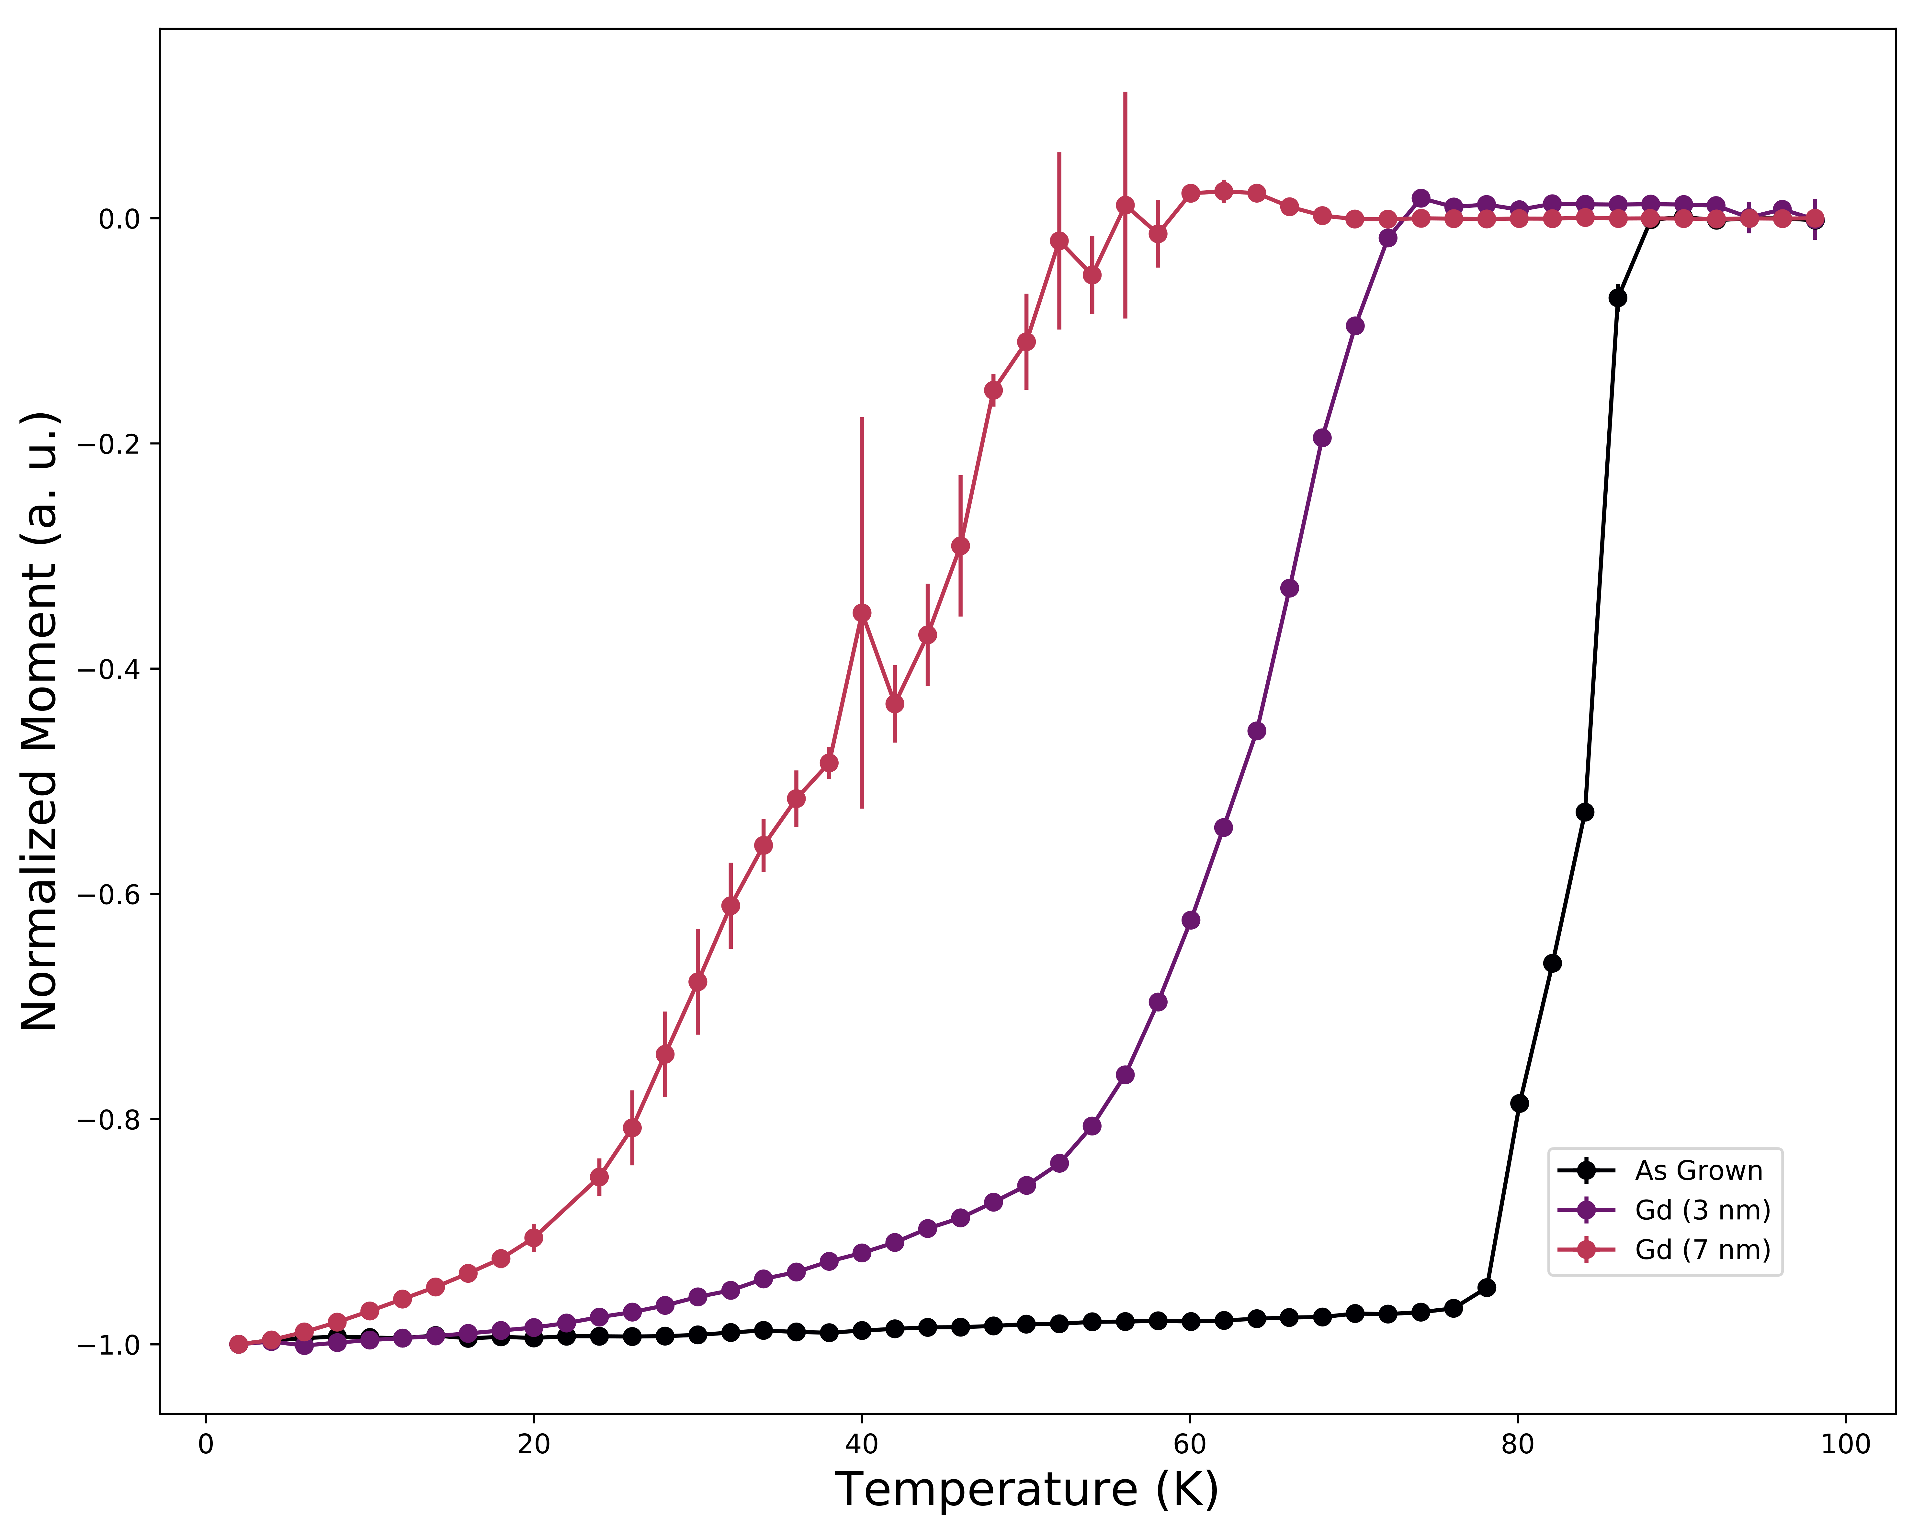
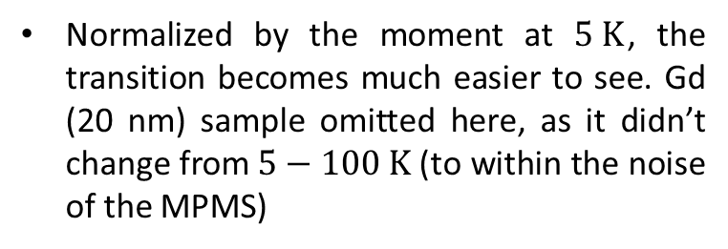
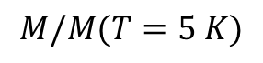
Magnetometry
$$M/M(T=5 K)$$
Normalized by the moment at $5 K$, the transition becomes much easier to see. Gd (20 nm) sample omitted here, as it didn’t change from $5−100 K$ (to within the noise of the MPMS)

Slide 11
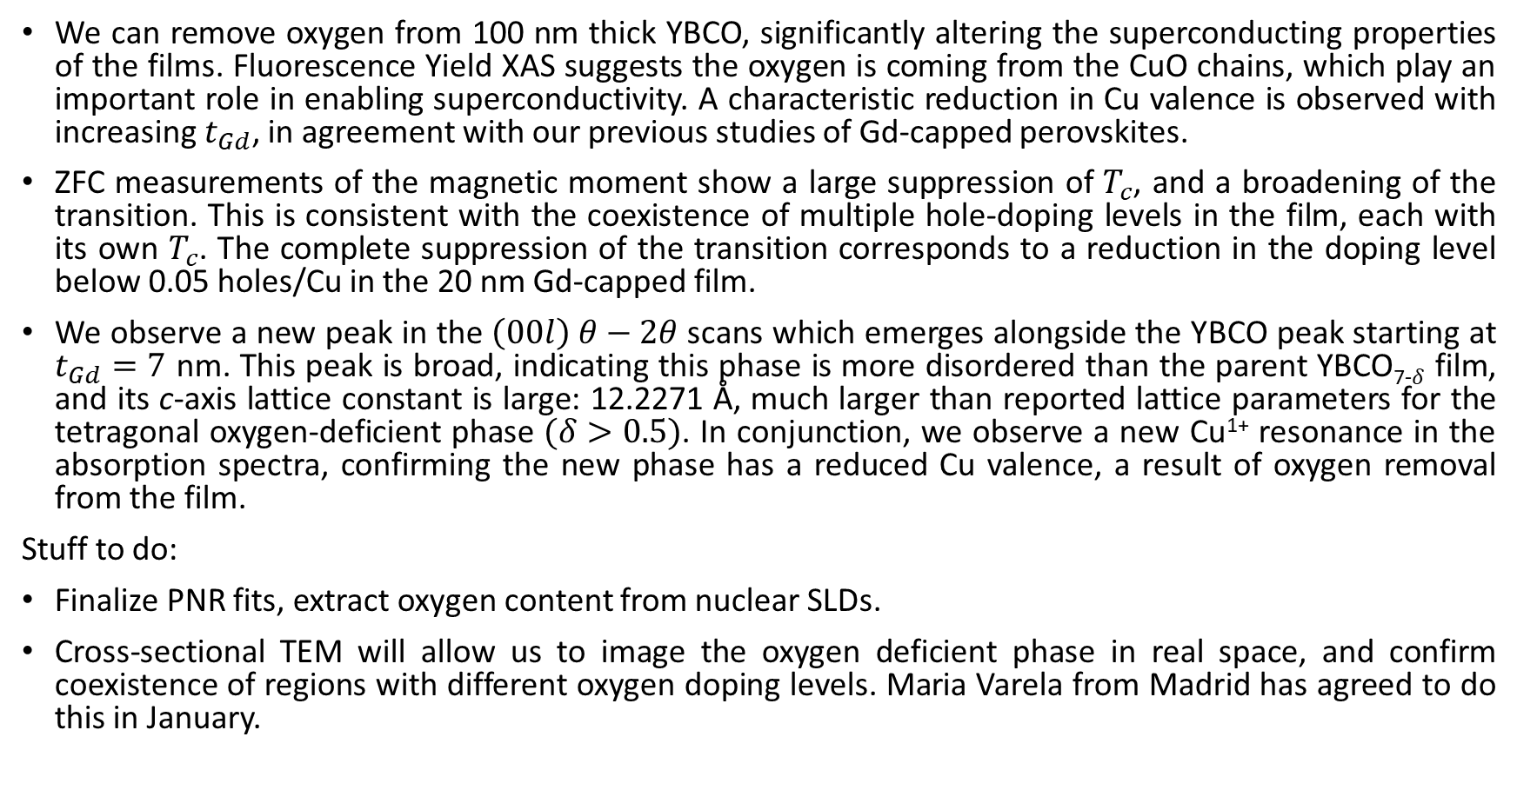
Summary
We can remove oxygen from 100 nm thick YBCO, significantly altering the superconducting properties of the films. Fluorescence Yield XAS suggests the oxygen is coming from the CuO chains, which play an important role in enabling superconductivity. A characteristic reduction in Cu valence is observed with increasing $t_{Gd}$, in agreement with our previous studies of Gd-capped perovskites.
ZFC measurements of the magnetic moment show a large suppression of $T_{c}$, and a broadening of the transition. This is consistent with the coexistence of multiple hole-doping levels in the film, each with its own $T_{c}$. The complete suppression of the transition corresponds to a reduction in the doping level below 0.05 holes/Cu in the 20 nm Gd-capped film.
We observe a new peak in the $\left(00l\right) θ−2θ$ scans which emerges alongside the YBCO peak starting at $t_{Gd}=7$ nm. This peak is broad, indicating this phase is more disordered than the parent YBCO₇₋$δ$ film, and its c-axis lattice constant is large: 12.2271 Å, much larger than reported lattice parameters for the tetragonal oxygen-deficient phase $(δ>0.5)$. In conjunction, we observe a new Cu¹⁺ resonance in the absorption spectra, confirming the new phase has a reduced Cu valence, a result of oxygen removal from the film.
Stuff to do:
Finalize PNR fits, extract oxygen content from nuclear SLDs.
Cross-sectional TEM will allow us to image the oxygen deficient phase in real space, and confirm coexistence of regions with different oxygen doping levels. Maria Varela from Madrid has agreed to do this in January.

